Slide 1
WEB PROGRAMMING TRAiNING
BY
A.D. Adekale,
Ja’afar Sadiq,
Muhammed B. Ibrahim,
Erasmus E. Obeth

Slide 2
Day 7 CSS
CSS stands for Cascading Style Sheets.
HTML was created to describe the content of a web page.
CSS is used to define styles for your web pages, including the design, layout and variations in display for different devices and screen sizes.
Saves a lot of work by controlling the layout of multiple web pages all at once.

Slide 3
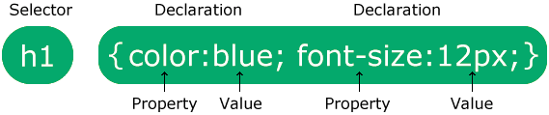
CSS SYNTAX
The selector points to the HTML element you want to style.
The declaration block contains one or more declarations separated by semicolons.
Each declaration includes a CSS property name and a value, separated by a colon.
Multiple CSS declarations are separated with semicolons, and declaration blocks are surrounded by curly braces.

Slide 4
SELECTING WHAT YOU WANT TO STYLE!
CSS element tag Selector
Selects HTML elements based on the element name.
CSS id Selector
Uses the id attribute of an HTML element to select a specific element.
The id of an element is unique within a page, so the id selector is used to select one unique element!
To select an element with a specific id, write a hash (#) character, followed by the id of the element.

Slide 5
CSS class Selector
Selects HTML elements with a specific class attribute.
To select elements with a specific class, write a period (.) character, followed by the class name.
CSS Universal Selector
The universal selector (*) selects all HTML elements on the page.
CSS Grouping Selector
The grouping selector selects all the HTML elements with the same style definitions.

Slide 6
Selector | Example | Example Description
#id-name | #firstname | Selects only a with id=”firstname”
.classname | .blue-box | Selects all elements with class=”blue-box”
* | * | Selects all elements in the page
Element.classname | H1.blue | Selects only <h1 class=”blue”><h1/>
Element | p | Selects only <p></p> element tags in the page
element, element, ... | P, div, img, audio, video | Selects <p></p> <div></div> <audio></audio> <video></video> tags

Slide 7
Inline CSS
Directly included as your html tag attribute
<h1 style="color:blue;text-align:center;">This is a heading</h1>
Internal CSS
include this inside your <head> opening and closing tag
<style>
body {
background-color: linen;}
h1 {
color: maroon;
margin-left: 40px;}
</style>

Slide 8
External CSS
You include this line below in all your html files that will use your css rules (file) in between your <head> opening and closing tag
<link rel="stylesheet" href="path-to-your-css-file/mystyle.css">
HTML and CSS Comments
Comments are used to explain the code, and may help when you edit the source code at a later date.
Comments are ignored by browsers.
Example
css
/* This is a single-line comment */
html
<!-- These paragraphs will be red -->

Slide 9
CSS Properties
Color
Background: color, image
Border: top, right, bottom ,left, color ,style
Margin: top, right, bottom ,left ,color
Padding: top, right, bottom ,left ,color
Font
Heigth/Width

Slide 10


Slide 11
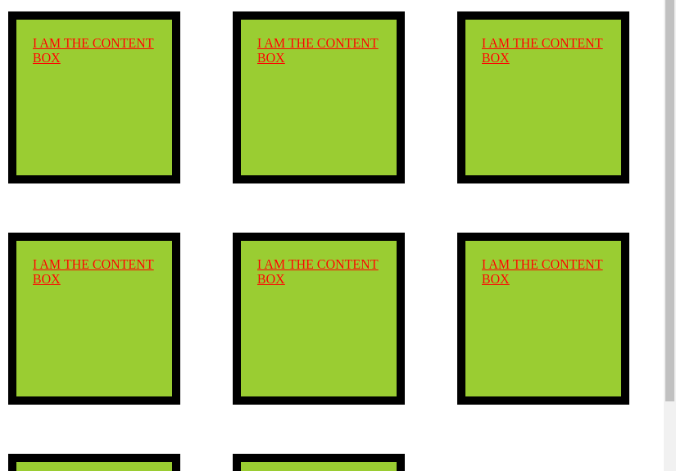
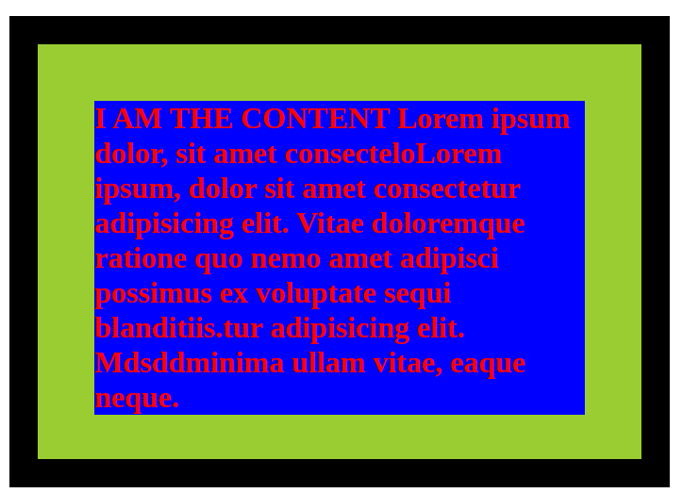
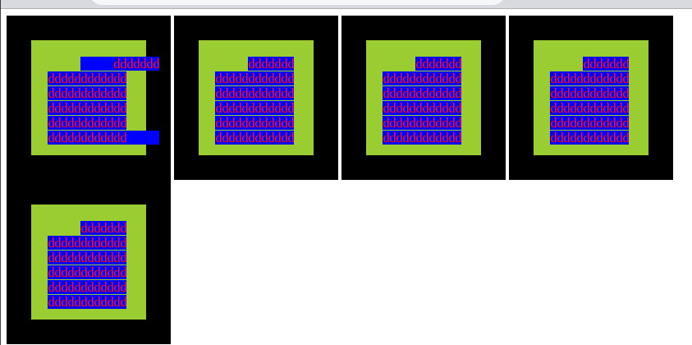

Slide 12
CSS Colors
We can give to color almost anything in html using css
Colors are specified using color names, or RGB, HEX, HSL, RGBA, HSLA values.
CSS Color Names
Red, Blue, green, Yellow, Tomato, Orange, Gray, Black, Voilet
CSS Color RGB
rgb(red, green, blue)
rgb(255, 99, 71)
CSS Color HEX
xxxxxx
x can be any value from 0 t0 9 and A to F
example 00ffe1, 000000 ,111111, efab13

Slide 13
Learn More About HTML AND CSS
Visit this website:
https://www.w3schools.com/

